Slide 1
Vidyalankar Polytechnic
Program: Information Technology

Slide 2
Group No:- IFA6
Soham Bandbe - 22202A0066
Apurva Pednekar - 22202A0036
Vardhan Khobarekar - 22202A0062
Yash Patil - 22202A0063
Under the guidance of:
Ms. Gauri Bobade
AY 2024-2025

Slide 3
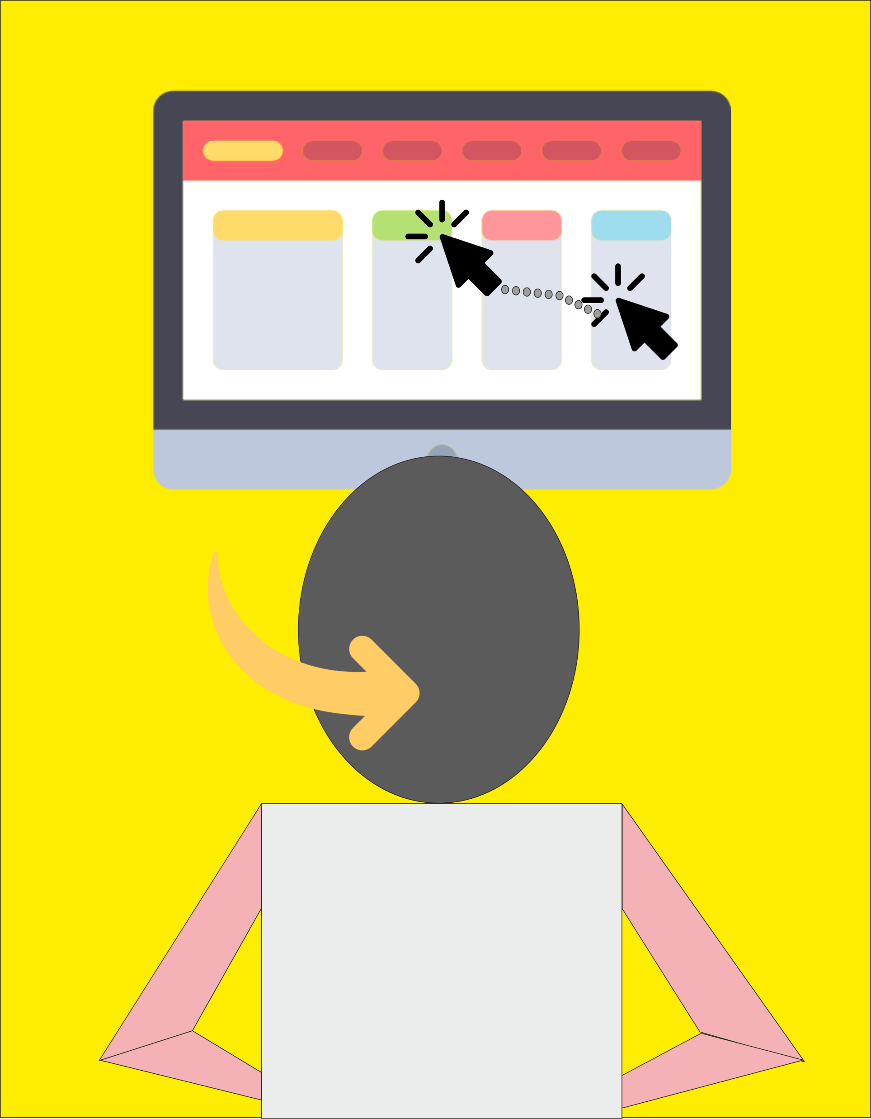
Project Domain : Application Software
Project Title : Hands-free navigation technology for people with disabilities
Category : Society / Product

Slide 4
Abstract
The Face-Controlled Mouse is an accessible, hands-free computer control system designed for individuals with physical disabilities. Using computer vision through OpenCV and MediaPipe, it converts facial gestures into mouse actions. Head movements control the cursor, eye blinks register clicks, and mouth gestures pause or resume actions—all without physical touch. This inclusive technology enhances accessibility, aiming to provide a smooth, touch-free experience for users, with potential for added features like scrolling and voice commands.

Slide 5
Introduction
Introducing an innovative project that reimagines accessibility by transforming facial gestures into seamless control for digital devices.
Acting as a virtual mouse, this hands-free system cuts the need for physical contact or external peripherals, making it a significant change for individuals with physical limitations.
With only a webcam as its hardware requirement, the technology uses facial recognition and gesture interpretation to detect movements such as eye blinks and mouth gestures, instantly translating them into cursor actions and device commands.
This technology allows users to effortlessly navigate applications, open and close windows, and perform basic task like clicking all through intuitive facial gestures.

Slide 6
Problem Statement
The Face-Controlled Mouse minimizes the need for external hardware, allowing users to control devices through facial gestures. This hands-free solution redefines accessibility and efficient human-device interaction. Unlike traditional systems requiring physical input or specialized hardware, this project uses a simple webcam, making it a cost-effective, widely accessible alternative. With facial gesture recognition, it offers a highly intuitive and precise touchless experience that is easy to set up and user-friendly.

Slide 7
Features of the project
Hands-Free Control: Enables users to control devices without using their hands, enhancing convenience and accessibility.
Gesture Recognition: Uses camera or sensor technology to interpret user gestures, allowing intuitive control through movement.
Responsiveness: Quickly and accurately responds to user actions, providing a smooth and seamless interaction experience.
User Base: Including those with limited mobility or special needs.
Touchless Interaction: Allows users to interact with devices without physical contact, enhancing hygiene and convenience.

Slide 8
Literature Review / Market Survey
Feature | Existing System | Proposed System
Hands-Free Control | Requires specialized equipment | Uses standard webcam
Hardware | Additional hardware needed | Webcam only
Ease of Use | Complex setup | Simple, user-friendly
Implementation | Requires proprietary software | Minimal setup
Touchless | Often requires physical contact | Fully touchless with facial gestures

Slide 9
Modules
Gesture Recognition Module:
Captures and interprets user hand, head, and eye gestures through the webcam or other sensors.
Mouse Control Module:
Translates detected gestures into mouse movements along the 8 axes and performs click actions.
Command Mapping and Filtering Module:
Processes and maps gestures to ensure smooth navigation and prevent unintentional cursor jumps.
User Interface Module: Provides a small GUI for configuring movement sensitivity and click gesture type.

Slide 10
Algorithm
Step 1: Initialize System and Setup Camera
Start by initializing the camera and setting up head movement and eye recognition software.
Step 2: Detect User Presence
Objective: Identify if the user is within the camera’s view.
Action:
If a face is detected, proceed to the next step.
If no face is detected, pause the system until a face is detected.
Step 3: Identify Facial Landmarks
Objective: Use facial landmark detection to recognize key points around the eyes and nose.
Setup:
Detect the user’s nose position as the cursor.
Capture the initial head position to set a neutral base reference.

Slide 11
Algorithm
Step 4: Track Nose Movements for Cursor Control
Objective: Move the cursor according to the nose position.
Action:
Track the nose's movement across the screen to control the cursor.
Define directional movements based on nose movement patterns:
Move cursor left or right when the nose moves left or right.
Move cursor up or down when the nose moves up or down.
Update the cursor position in real time based on nose position changes.
Step 5: Detect Eye Movements for Click Commands
Objective: Detect specific eye gestures for click actions.
Actions:
Left eye closed for 3sec : to execute a left-click command.
Right eye closed for 3sec : to trigger a right-click action.

Slide 12
Algorithm
Step 6: Feedback and Error Handling
Objective: Provide feedback and handle unrecognized gestures.
Action:
Display feedback on the screen for the user to confirm cursor movement.
If an unrecognized movement is detected, prompt the user to recalibrate.
Step 9: Loop and Continuously Monitor
Objective: Continuously track the user’s nose and eye movements.
Action:
Repeat Steps 4 through 8 to ensure ongoing detection and response.
Pause the system if the user leaves the frame, resuming when they re-enter.
Step 10: Exit or System Shutdown
Objective: Properly close the program.
Action:
When the user chooses to exit, close the camera feed and log any necessary data before shutting down.

Slide 13
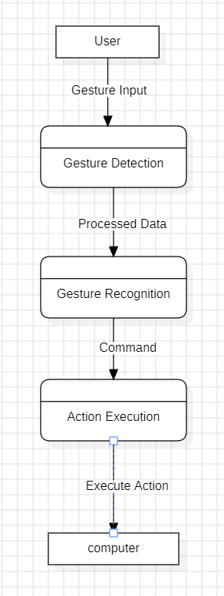
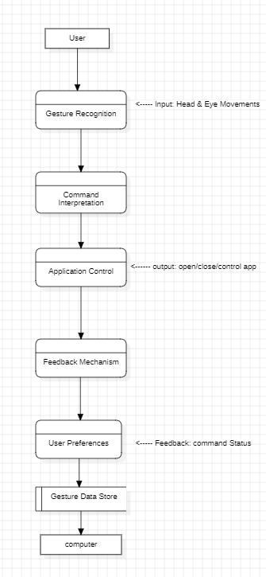
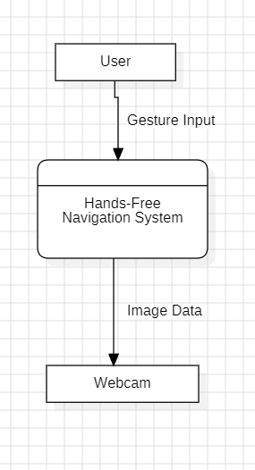
DFD (DFD 0,1,2 diagram)

Slide 14
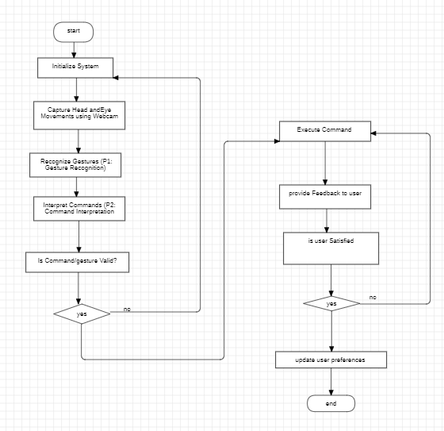
UML Diagrams (Flowchart)

Slide 15
Technologies Used
Hardware Requirements:
Webcam: For gesture and movement recognition
Computer/Device: Capable of processing image and gesture data
Display Screen: For visual feedback and interaction
Software Requirements:
Operating System: Windows, macOS, or Linux
Python: For scripting and implementing algorithms
OpenCV: For computer vision and gesture recognition
MediaPipe: For hand and eye tracking, gesture detection
IDE: VS Code for coding and debugging
Front End:
GUI Frameworks: Tkinter for user interfaces
Back End:
Python: For backend logic and command processing

Slide 16
Pros and Cons
Pros:
Increased Accessibility: Empowers individuals with limited mobility to interact with devices.
Enhanced User Autonomy: Enables hands-free navigation, fostering independence.
Versatile Use Cases: Applicable across education, healthcare, entertainment, and professional settings.
Cost-Effective: Utilizes standard hardware like webcams, lowering equipment costs.
Touchless Interaction: Promotes hygiene by reducing physical contact with surfaces.
Cons:
Environmental Limitations: Requires proper lighting and minimal background.
Extended Use: Prolonged gesture use may cause discomfort or fatigue.
Privacy and Security Concerns: Continuous camera use can raise privacy issues.

Slide 17
Future Scope
Enhanced Gesture Recognition Accuracy:
Improve precision to detect subtle movements across various environments.
Cross-Platform Compatibility:
Ensure seamless functionality across smartphones, smart TVs, tablets, and assistive devices.
Incorporation of Voice Commands:
Enable multi-modal interaction by combining gestures with voice control.
Greater Customization Options:
Provide adjustable gesture sensitivity, custom command mapping, and accessibility preferences.
Collaborative Tools and Remote Control:
Facilitate remote control of appliances, robotics, and smart home devices for enhanced independence.

Slide 18
Applications
Assistive Technology: Enables individuals with limited mobility to interact with computers and smart devices using head or eye movements for tasks like internet browsing and document management.
Education: Enhances accessibility for students with disabilities, facilitating easier access to learning resources and virtual classrooms.
Healthcare & Rehabilitation: Serves as a therapeutic tool for physical therapy and strengthening exercises, aiding recovery for patients with injuries.
Workplace Inclusivity: Empowers employees with disabilities to manage workflows and participate in virtual meetings, broadening employment opportunities.
Public Services: Integrates into kiosks, ticket machines, and ATMs, making services more user-friendly for individuals with disabilities.

Slide 19
Conclusion
The hands-free navigation project for individuals with disabilities signifies a transformative leap toward more inclusive and accessible technology. By utilizing head and eye movement recognition, this solution eliminates traditional barriers to digital interaction, allowing users to engage with devices without physical input.

Slide 20
Questions …???

Slide 21
Thank You …!!!

